Slide 1

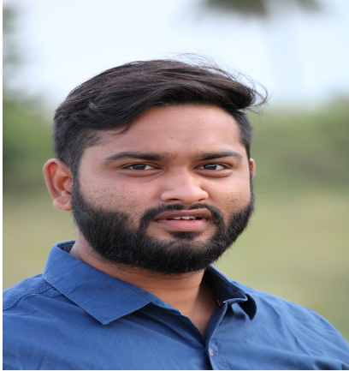





Rohith P
Education and certificates
Bachelor of Technology Computer Science : 2016 - 2020
Analyst/Software Engineer
Skills
Spring Boot
Java
JPA CRUD
Bootstrap
React JS
Angular
Base Location: ^{Bangalore}
Email ID:
Rohith.p@capgemini.com
_{Mobile No:} +91 9030209842
Grade:
A4
Strengths
Full Stack Developer
Hands on experience in developing microservices with Spring Boot, JPA crud operations, Spring Cloud and Eureka server.
Have good skills on core java and spring boot. created projects which has given me more scope on spring boot and spring cloud
Have good communication skills and very co-operative with the team which keeps me working efficiently.
Has some good knowledge on developing a web page using React Js and also been working with Angular.
Achivement
Crop-Deal Management System
Backend
MySQL
Postgres
REST-API
NodeJS
Completed end to end case study of Crop-Deal Management System along with JWT authentication, Swagger and Billing System using Spring boot Microservices with Eureka Server.
Used React JS for developing the front end part.
Web Technologies
HTML5 CSS3
Javascript/TypeScript
Online personal Photo products Shoppe.
Developed few functionalities using crud operations and able to establish communication between the microservices through Eureka server.
AddOns Github Maven Postman
Visual Studio
Learnt the concepts of Git, GitHub and has successfully completed course on ‘Successful Presentation and also on ‘Agile Software Development’ at Coursera
Additional Details
Adaptable
Team Management
Check out my work on GitHub & Video Profile
Presentation Title | Author | Date © Capgemini 2017. All rights reserved | 1

